Slide 1
Introduction to Machine Learning
General use cases and need for machine learning

Slide 2
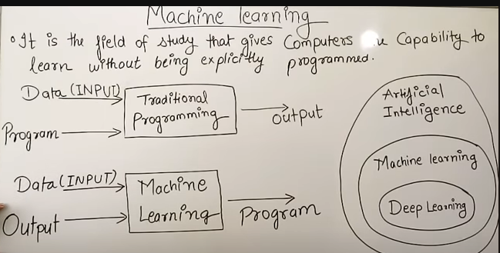

Slide 3
Need for machines to learn
Machine learning is using computer programming to improve/learn a performance criterion using example data or past experience.
Strategies to learn are several. There is a parallel with human learning
Learning is used when:
Human expertise does not exist (image recognition),
Humans are unable to explain their expertise (game playing)
Solution changes in time (rainfall and stock prices)
Solution needs to be adapted to particular cases (practically every use case)

Slide 4

Is information necessary to learn?
How do humans learn?
Elements and tasks
Repetition
Pattern recognition
Changing the “wiring of the mind”
Repetition
How to teach computers to learn?
Give tasks and performance criterion
Repetition
Repetition

Slide 5
Let’s improve the definition of Machine Learning
How to make machines learn?
Use mathematical models that
improve their performance
at some task
with experience
Optimize a performance criterion using example data or past experience.
Role of Statistics: Randomness has to be accounted for. Machines need to learn to separate noise from data
Role of Computer science: Efficient algorithms to
Create applications that can run algorithms fast
Create platforms that can leverage data in bulk
Solve large scale problems

Slide 6
What can we solve using ML
Machine learning is preferred approach to
Speech recognition, Natural language processing
Computer vision
Trends and charts
Artificial Intelligence
Classification, Prediction
How did ML get so hot?
Improved machine learning algorithms
Improved data ingestion, networking, faster computers
IoT
Mobile data and applications

Slide 7
Types of Machine Learning
Supervised Learning
Classification
Regression/Prediction
Unsupervised Learning
K-means clustering
Association Rules
Reinforcement Learning
Everything else

Slide 8
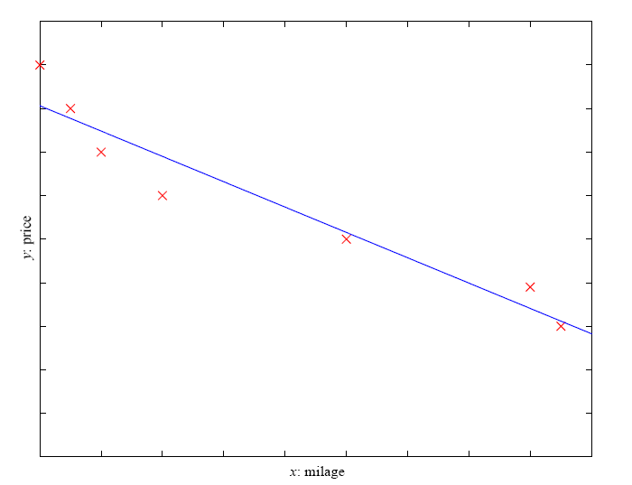
Prediction: Regression
Example: Price of a used car
x : car attributes
y : price
y = f (x | θ )
y = wx+w₀

Slide 9
Supervised Learning: Uses
Example: decision trees tools that create rules
Prediction of future cases: Use the rule to predict the output for future inputs
Classification from Historical data
Application of Statistical techniques
Create decision making trees
Analysing natural language

Slide 10
Unsupervised Learning
Using general purpose algorithms
Mathematically driven
Example applications
Customer segmentation in CRM
Image compression: Color quantization
Bioinformatics: Learning motifs

Slide 11
Reinforcement Learning
Forget everything
Figure out how human mind works
Use repetition and deluge of data
Make it learn from mistakes

